Slide 1
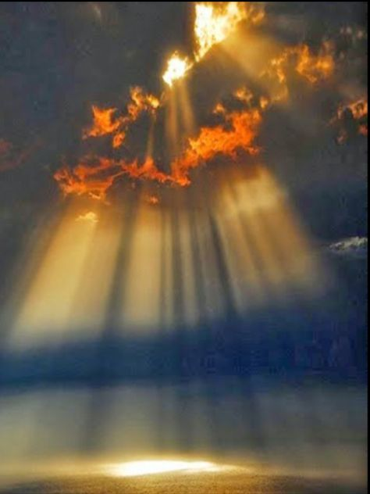
Uv Radiation and melanoma: A visual analysis
Shuja Sajjad – Michelle Handipranata

Slide 2
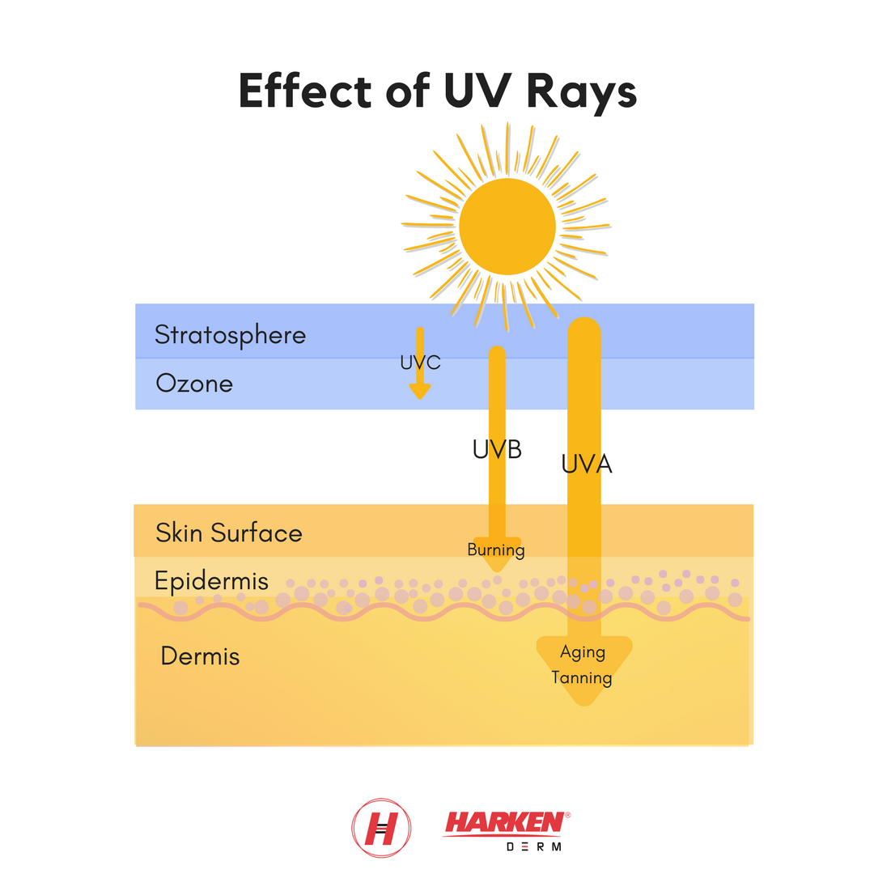
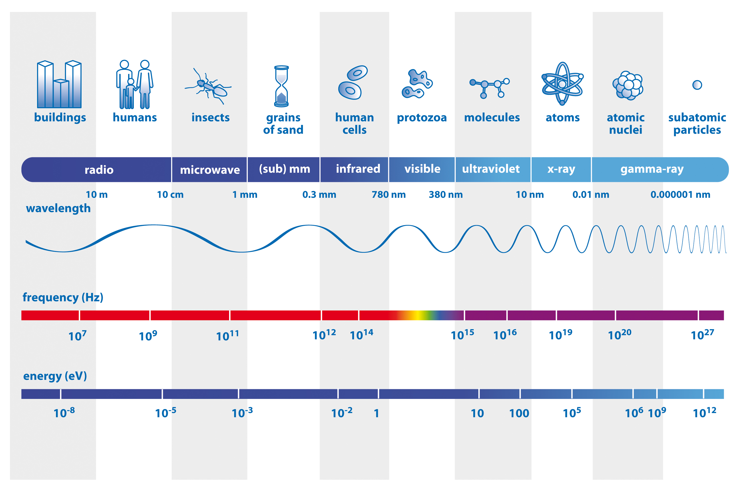
Uv radiation

Slide 3
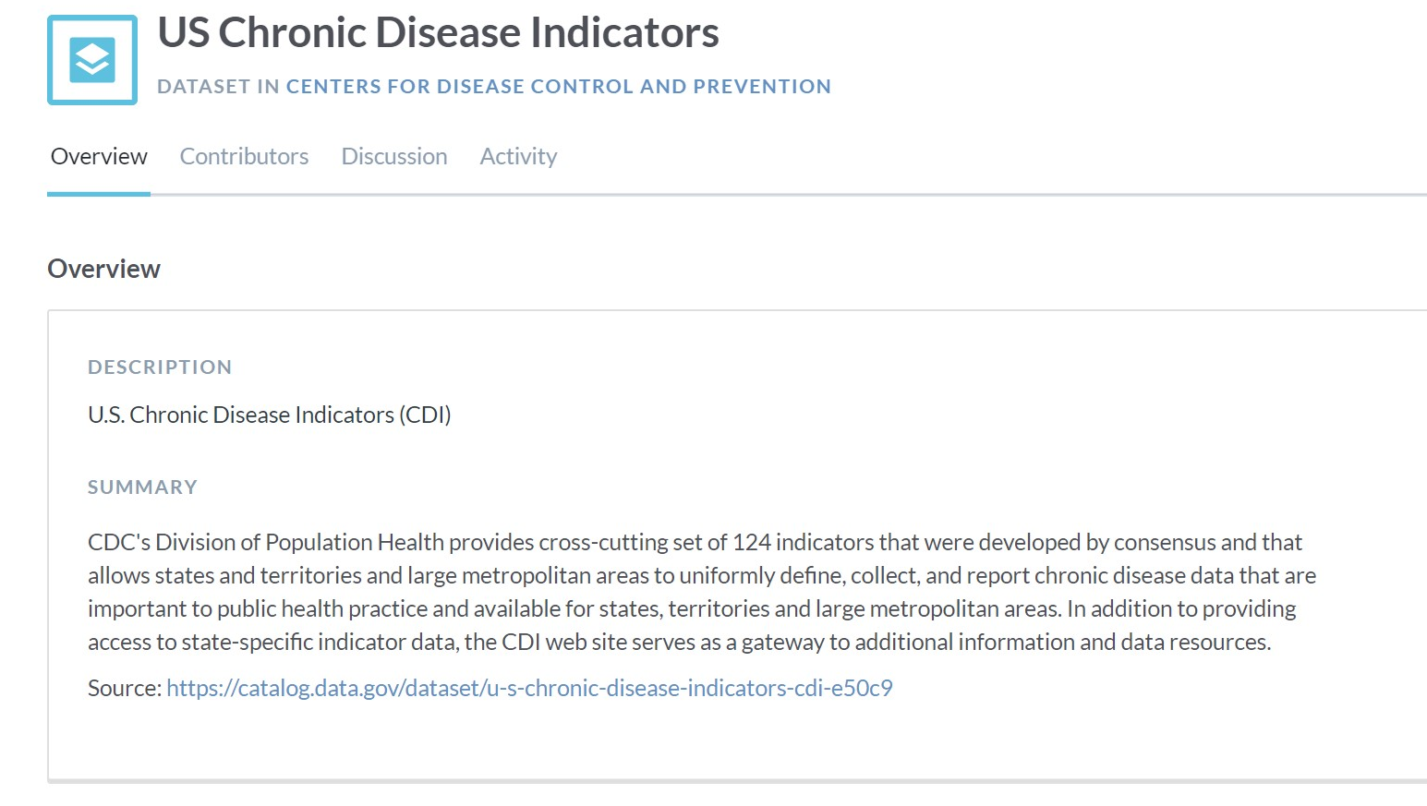
Finding the Data
∙ Sourced from the CDC
∙ Robust chronic disease data points
∙ Very granular, from states, down to county levels

Slide 4









ETL workflow

Slide 5
Share the site!

Slide 6

Questions? Comments?

